Slide 1
Data Structures
Lecture : Sorting Algorithms

Slide 2
Sorting
Process to convert the Unordered list to Ordered list.
Index | 0 | 1 | 2 | 3 | 4
Unordered list | 21 | 20 | 27 | 19 | 16
Index | 0 | 1 | 2 | 3 | 4
Ordered list | 16 | 19 | 20 | 21 | 27
Ascending order
Descending order

Slide 3
Sorting
Sort: arrange values into an order:
Alphabetical
Ascending numeric
Descending numeric
Three algorithms/approaches will be examined –
Bubble sort
Selection sort
Insertion sort

Slide 4
Bubble Sort
Concept:
Compare 1st two elements
If out of order, exchange them to put in order
Move down one element, compare 2nd and 3rd elements, exchange if necessary. Continue until end of array.
Pass through array again, exchanging as necessary
Repeat until pass made with no exchanges.

Slide 5
Step-by-step example
First Pass: ( 5 1 4 2 8 )
( 1 5 4 2 8 ), Swaps since 5 > 1. move on ( 1 4 5 2 8 ), Swap since 5 > 4. move on ( 1 4 2 5 8 ), Swap since 5 > 2. move on ( 1 4 2 5 8 ), does not swap. End of pass#1
2nd Pass: ( 1 4 2 5 8 )
( 1 4 2 5 8 ) does not swap. move on
( 1 2 4 5 8 ), Swap since 4 > 2. move on ( 1 2 4 5 8 ) does not swap. move on
( 1 2 4 5 8 ) does not swap. End of pass#2

Slide 6
Now, the array is already sorted, but the algorithm does not know if it is completed. The algorithm needs one whole pass without any swap to know it is sorted.
Third Pass: ( 1 2 4 5 8 )
( 1 2 4 5 8 )
( 1 2 4 5 8 )
( 1 2 4 5 8 ) Terminate.

Slide 7
Bubble Sort Function
/* Bubble sort for integers */
void SWAP(a,b) { int t; t=a; a=b; b=t; }
void bubble( int a[], int n ) {
int pass, i;
for(pass=0;pass<n-1;pass++) { // n-1 passes thru the array.
for(i=0;i<(n-1);i++)// From start to the end of unsorted part
{ // If adjacent items out of order, swap
if( a[i]>a[i+1] )
SWAP(a[i],a[i+1]);
}
}
}
This code will not be able to terminate the bubble sort operation on the third pass. Need to modify the algorithm.

Slide 8
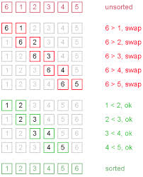
Example 2:

Slide 9
Bubble SortFunction (re-define)
void SWAP(a,b) { int t; t=a; a=b; b=t; }
void bubble( int a[], int n ) {
int pass, j, flag;
for(pass=0;pass<n-1;pass++) {//break if no swap
flag = 0;
for(j=0;j<(n-pass-1);j++) { //discard the last
if( a[j]>a[j+1] ) {
SWAP(a[j+1],a[j]); flag = 1;}
}
if (flag==0) break;
}
}

Slide 10
If there are n elements to be sorted then, the process mentioned here should be repeated n-1 times to get required result.
But, for better performance, in second step, last and second last elements are not compared because, the proper element is automatically placed at last after first step.
Similarly, in third step, last and second last and second last and third last elements are not compared and so on.

Slide 11
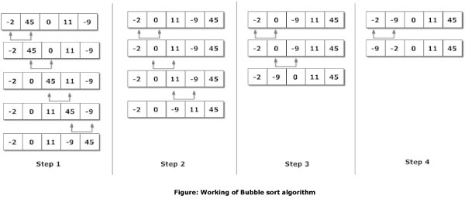

Slide 12
Bubble Sort - Tradeoffs
Benefit:
Easy to understand and implement
Disadvantage:
Inefficient: slow for large arrays

Slide 13
Selection Sort
Concept for sort in ascending order:
Locate smallest element in array. Exchange it with element in position 0
Locate next smallest element in array. Exchange it with element in position 1.
Continue until all elements are arranged in order

Slide 14
Selection Sort - Example
Array numlist contains:
Smallest element is 2. Exchange 2 with element in 1st position in array:
11 | 2 | 29 | 3
2 | 11 | 29 | 3

Slide 15
Example (Continued)
Next smallest element is 3. Exchange 3 with element in 2nd position in array:
Next smallest element is 11. Exchange 11 with element in 3rd position in array:
2 | 3 | 29 | 11
2 | 3 | 11 | 29

Slide 16
A Selection Sort Function:
void selectionSort(int array[], int n) { int select, minIndex, minValue; for (select = 0; select < (n - 1); select++) { //select the location and find the minimum value minIndex = select; minValue = array[select]; for(int i = select + 1; i < n; i++) { //start from the next of selected one to find minimum if (array[i] < minValue) { minValue = array[i]; minIndex = i; } } array[minIndex] = array[select]; array[select] = minValue; } }

Slide 17
Selection Sort
/* sorting element in ascending order */
int i, j, k, tempVal, List[100];
/* find the smallest value for index i */
for ( i=0; i<n-1; ++i ){
k = i; // consider value in k as smallest
/* compare with rest of the element in index j*/
for ( j=i+1; j<n; ++j )
/* change k to j if value at index j is small */
if( List[k] > List[j] ) k = j;
/* interchange if value at index k is small */
tempVal = List[i];
List[i] = List[k];
List[k] = tempVal;
}
Concept
Locate smallest element in array. Interchange it with element in position 0.
Locate next smallest element in array. Interchange it with element in position 1.
Continue until all elements are arranged in order
i
i
i
i
i
i
i
i
i
Benefit: More efficient than Bubble Sort, since fewer exchanges
Disadvantage: May not be as easy as Bubble Sort to understand
j
j
j
j
j
j
j
j
j
11
22
66
22
33
66
44
55
77
33
66
11
77
91
77
88
91
55
91
33
99
88
99
44
k
k
k
k
k
k
k
k
k
k

Slide 18
Let’s see another example of selection sorting

Slide 19
i | j | Comparing list[i] > list[j] |  |  |  |  |  |  |  |  | Swapping if true
 |  | 0 | 1 | 2 | 3 | 4 | 5 | 6 | 7 | 8 | 0 | 1 | 2 | 3 | 4 | 5 | 6 | 7 | 8
0 | 1 | 3 | 5 | -3 | 2 | 7 | -2 | 8 | 6 | 4
 | 2 | 3 | 5 | -3 | 2 | 7 | -2 | 8 | 6 | 4 | -3 | 5 | 3 | 2 | 7 | -2 | 8 | 6 | 4
 | 3 | -3 | 5 | 3 | 2 | 7 | -2 | 8 | 6 | 4
 | 4 | -3 | 5 | 3 | 2 | 7 | -2 | 8 | 6 | 4
 | 5 | -3 | 5 | 3 | 2 | 7 | -2 | 8 | 6 | 4
 | 6 | -3 | 5 | 3 | 2 | 7 | -2 | 8 | 6 | 4
 | 7 | -3 | 5 | 3 | 2 | 7 | -2 | 8 | 6 | 4
 | 8 | -3 | 5 | 3 | 2 | 7 | -2 | 8 | 6 | 4

Slide 20
i | j | Comparing list[i] > list[j] |  |  |  |  |  |  |  |  | Swapping if true
 |  | 0 | 1 | 2 | 3 | 4 | 5 | 6 | 7 | 8 | 0 | 1 | 2 | 3 | 4 | 5 | 6 | 7 | 8
1 | 2 | -3 | 5 | 3 | 2 | 7 | -2 | 8 | 6 | 4 | -3 | 3 | 5 | 2 | 7 | -2 | 8 | 6 | 4
 | 3 | -3 | 3 | 5 | 2 | 7 | -2 | 8 | 6 | 4 | -3 | 2 | 5 | 3 | 7 | -2 | 8 | 6 | 4
 | 4 | -3 | 2 | 5 | 3 | 7 | -2 | 8 | 6 | 4
 | 5 | -3 | 2 | 5 | 3 | 7 | -2 | 8 | 6 | 4 | -3 | -2 | 5 | 3 | 7 | 2 | 8 | 6 | 4
 | 6 | -3 | -2 | 5 | 3 | 7 | 2 | 8 | 6 | 4
 | 7 | -3 | -2 | 5 | 3 | 7 | 2 | 8 | 6 | 4
 | 8 | -3 | -2 | 5 | 3 | 7 | 2 | 8 | 6 | 4

Slide 21
i | j | Comparing list[i] > list[j] |  |  |  |  |  |  |  |  | Swapping if true
 |  | 0 | 1 | 2 | 3 | 4 | 5 | 6 | 7 | 8 | 0 | 1 | 2 | 3 | 4 | 5 | 6 | 7 | 8
2 | 3 | -3 | -2 | 5 | 3 | 7 | 2 | 8 | 6 | 4 | -3 | -2 | 3 | 5 | 7 | 2 | 8 | 6 | 4
 | 4 | -3 | -2 | 3 | 5 | 7 | 2 | 8 | 6 | 4
 | 5 | -3 | -2 | 3 | 5 | 7 | 2 | 8 | 6 | 4 | -3 | -2 | 2 | 5 | 7 | 3 | 8 | 6 | 4
 | 6 | -3 | -2 | 2 | 5 | 7 | 3 | 8 | 6 | 4
 | 7 | -3 | -2 | 2 | 5 | 7 | 3 | 8 | 6 | 4
 | 8 | -3 | -2 | 2 | 5 | 7 | 3 | 8 | 6 | 4

Slide 22
i | j | Comparing list[i] > list[j] |  |  |  |  |  |  |  |  | Swapping if true
 |  | 0 | 1 | 2 | 3 | 4 | 5 | 6 | 7 | 8 | 0 | 1 | 2 | 3 | 4 | 5 | 6 | 7 | 8
3 | 4 | -3 | -2 | 2 | 5 | 7 | 3 | 8 | 6 | 4
 | 5 | -3 | -2 | 2 | 5 | 7 | 3 | 8 | 6 | 4 | -3 | -2 | 2 | 3 | 7 | 5 | 8 | 6 | 4
 | 6 | -3 | -2 | 2 | 3 | 7 | 5 | 8 | 6 | 4
 | 7 | -3 | -2 | 2 | 3 | 7 | 5 | 8 | 6 | 4
 | 8 | -3 | -2 | 2 | 3 | 7 | 5 | 8 | 6 | 4

Slide 23
i | j | Comparing list[i] > list[j] |  |  |  |  |  |  |  |  | Swapping if true
 |  | 0 | 1 | 2 | 3 | 4 | 5 | 6 | 7 | 8 | 0 | 1 | 2 | 3 | 4 | 5 | 6 | 7 | 8
4 | 5 | -3 | -2 | 2 | 3 | 7 | 5 | 8 | 6 | 4 | -3 | -2 | 2 | 3 | 5 | 7 | 8 | 6 | 4
 | 6 | -3 | -2 | 2 | 3 | 5 | 7 | 8 | 6 | 4
 | 7 | -3 | -2 | 2 | 3 | 5 | 7 | 8 | 6 | 4
 | 8 | -3 | -2 | 2 | 3 | 5 | 7 | 8 | 6 | 4 | -3 | -2 | 2 | 3 | 4 | 7 | 8 | 6 | 5

Slide 24
i | j | Comparing list[i] > list[j] |  |  |  |  |  |  |  |  | Swapping if true
 |  | 0 | 1 | 2 | 3 | 4 | 5 | 6 | 7 | 8 | 0 | 1 | 2 | 3 | 4 | 5 | 6 | 7 | 8
5 | 6 | -3 | -2 | 2 | 3 | 4 | 7 | 8 | 6 | 5
 | 7 | -3 | -2 | 2 | 3 | 4 | 7 | 8 | 6 | 5 | -3 | -2 | 2 | 3 | 4 | 6 | 8 | 7 | 5
 | 8 | -3 | -2 | 2 | 3 | 4 | 6 | 8 | 7 | 5 | -3 | -2 | 2 | 3 | 4 | 5 | 8 | 7 | 6

Slide 25
i | j | Comparing list[i] > list[j] |  |  |  |  |  |  |  |  | Swapping if true
 |  | 0 | 1 | 2 | 3 | 4 | 5 | 6 | 7 | 8 | 0 | 1 | 2 | 3 | 4 | 5 | 6 | 7 | 8
6 | 7 | -3 | -2 | 2 | 3 | 4 | 5 | 8 | 7 | 6 | -3 | -2 | 2 | 3 | 4 | 5 | 7 | 8 | 6
 | 8 | -3 | -2 | 2 | 3 | 4 | 5 | 7 | 8 | 6 | -3 | -2 | 2 | 3 | 4 | 5 | 6 | 8 | 7

Slide 26
i | j | Comparing list[i] > list[j] |  |  |  |  |  |  |  |  | Swapping if true
 |  | 0 | 1 | 2 | 3 | 4 | 5 | 6 | 7 | 8 | 0 | 1 | 2 | 3 | 4 | 5 | 6 | 7 | 8
7 | 8 | -3 | -2 | 2 | 3 | 4 | 5 | 6 | 8 | 7 | -3 | -2 | 2 | 3 | 4 | 5 | 6 | 7 | 8

Slide 27
Selection Sort - Tradeoffs
Benefit:
More efficient than Bubble Sort, since fewer exchanges
Disadvantage:
May not be as easy as Bubble Sort to understand

Slide 28
Insertion Sort
Mark first element as sorted,
Next for each unsorted element
'extract' the element
for i = last Sorted Index to 0
if current SortedElement > extracted Element
move/shift sorted element to the right by 1
else: insert extracted element

Slide 29
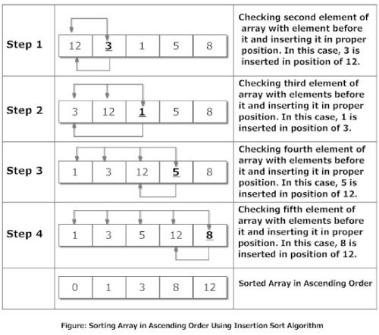
How insertion sort Algorithm works?

Slide 30
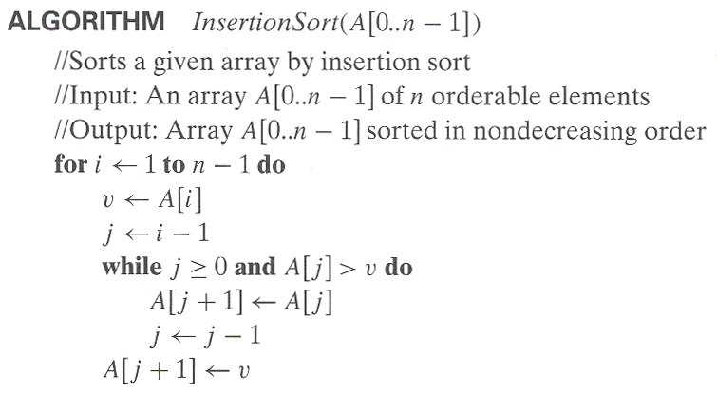
Insertion Sort
To sort array A[0..n-1], sort A[0..n-2] recursively and then insert A[n-1] in its proper place among the sorted A[0..n-2]
Usually implemented bottom up (non-recursively)
Example: 6, 4, 1, 8, 5 6 | 4 1 8 5
4 6 | 1 8 5
1 4 6 | 8 5
1 4 6 8 | 5
1 4 5 6 8
0 1 2 3 4

Slide 31
Example: The following table shows the steps for sorting the sequence {3, 7, 4, 9, 5, 2, 6, 1}. In each step, the item under consideration is underlined. The item that was moved (or left in place because it was biggest yet considered) in the previous step is shown in bold.
3 7 4 9 5 2 6 1
3 7 4 9 5 2 6 1
3 4 7 9 5 2 6 1
3 4 7 9 5 2 6 1
3 4 5 7 9 2 6 1
2 3 4 5 7 9 6 1
2 3 4 5 6 7 9 1
1 2 3 4 5 6 7 9

Slide 32
Insertion Sort
/* sorting element in ascending order */
int i, j, v, List[100];
/* start with the 2nd element */
for ( i=1; i<n; ++i ){
v = List[i]; // store the current value
j = i - 1; // go for the previous element
/* compare with the previous elements in index j */
while( j >= 0 && List[j] > v ){
/* move forward if value at index j is large */
List[j+1] = List[j];
j--; // go for the next previous element
}
List[j+1] = v; // store current value
}
Concept
Start with the 2nd element.
Compare backwards with all previous (current index down to 0) elements.
While the previous elements are large move the element one index forward.
Stop and store the 2nd element where the previous element is not large.
Continue with rest of the element forward as above.
i
i
i
i
i
i
i
i
i
Benefit: May be efficient than Bubble Sort, but less than selection sort.
Disadvantage: May not be as easy as other Sorting algorithm to understand
j
j
j
j
j
j
j
j
j
j
66
22
99
77
11
91
55
88
44
v
22
11
33
66
33
22
66
33
22
77
66
55
44
99
77
99
77
66
55
99
91
77
66
11
99
91
88
77
91
55
99
91
88
88
99
91
44
99
0
1
2
3
4
5
6
7
8
9

Slide 33
Pseudocode of Insertion Sort

Slide 34
Ref. link
http://visualgo.net/
http://en.wikipedia.org/wiki/Bubble_sort#mediaviewer/File:Bubble-sort-example-300px.gif
https://www.youtube.com/watch?v=JP5KkzdUEYI
http://en.wikipedia.org/wiki/Selection_sort#mediaviewer/File:Selection-Sort-Animation.gif

